Slide 1
Plantera
Farm automation system

Slide 2
—Audrey Hepburn
“To plant a garden is to believe in
Tomorrow.”

Slide 3
Table of contents
Problems
Competition and Market Landscape
01.
04.
Project Proposal
Progress Status
02.
05.
Solution Features
Future Plans
03.
06.
The most important problems and obstacles of agriculture
Solution Description
What is done
Project features that are offered to the user
What is done and the plan for the future

Slide 4
Introduction
Agricultural plays important role in the Egyptian economy, as the total domestic production of agriculture, is approximated to 11.4% of the economy, and 23.8% of the total workers in Egypt work in it, but the productivity of agricultural decreased in the period between 1991 and 2019 by 5.8% of the GDP, which led to a decline in the productivity of many strategic crops such as cotton, wheat, maize, beans, and oil crops. Therefore, Egypt suffers from constant challenges and problems regarding the agricultural sector and its negative effects on production.

Slide 5
01
Problems
The most important problems and obstacles of agriculture

Slide 6
Problems
Not providing healthy and accurate care for plants.
Wasting large amounts of irrigation water, as agriculture drains about 86% of Egypt’s water that it gets from the Nile River which is approximately 55.5 billion cubic meters annually of water, which negatively affects the soil and deteriorates its fertility.
The farmer's inability to determine the needed amount of water and fertilizer required for each crop.
Excessive use of pesticides and chemical fertilizers.

Slide 7
Problems
Decreasing the rate of agricultural products due to the lack of agricultural technology.
Many insect and pathological pests and plant diseases, and sometimes they are treated incorrectly.
The lack of modern irrigation systems, whether it’s sprinkler or drip irrigation.
The labor force resorts to moving to other regions to search for other job opportunities.

Slide 8
02
Project proposal
Solution Description

Slide 9
Solution Description
Plantera is an integrated system for providing accurate and healthy plant care:
- It includes a smart irrigation system that irrigates the plant based on its need for water.
- It includes a system to monitor the temperature, air humidity, soil moisture, and soil pH and it detects if it is raining within the farm area.
- Providing a phone application to monitor and control the farm remotely.
- Providing a feature to detect plant diseases using camera or by uploading existing images and proposing treatment for the disease.
- provide a feature to predict the amount of crop based on soil properties.

Slide 10
03
Solution Features
Project features that are offered to the user

Slide 11
Solution Features
The system is integrated as it includes a smart irrigation system and a system for controlling and monitoring the farm remotely.
Suggest treatment for diseased plants.
The irrigation system monitors rain so that irrigation is not carried out on days when it is expected to rain.
The system works automatically without human intervention, which reduces manpower and reduces error rates.
Predicting the amount of crop based on soil properties, allowing the farmer to improve the soil to increase the amount of yield.

Slide 12
04
Competition and Market Landscape

Slide 13
Our competitors
Plantix
PictureThis
Planta
Agrio
Each of these competitors focuses on one or two agricultural solutions.
What differentiates us from our competitors is our system is more integrated than their system in some features.
We want to integrate into a broader system that can irrigate smartly, detect plant diseases, and also predict crop yield.

Slide 14
Our competitors
Plantix: This is a mobile application that can detect the disease of a plant and give treatment advice. It also offers cultivation tips.
PictureThis: This is a plant identifier that enables the user to take a picture of plants then introduce plant diagnosis if a plant or disease and just gives a water reminder not automatically irrigate but can track a plant through the need for sun or water.
Planta: This is also a mobile application that offers care of a plant for example it gives the user reminders to water the plant.

Slide 15
Our competitors
Agrio: is a plant health app that can identify plant problems with a snap of a photo, it can also recommend some treatment based on the plant disease detected.
In Our system Plantera we can compete by introducing a more integrated system that in which:
1- the user can take a snap of a photo then it can detect what is the disease,
2- Plantera can detect the approximate amount of crop to predict profit, and
3- this application is associated with a smart irrigation system that can irrigate soil periodically whenever the soil needs that. We can make the user up-to-date with
their farm circumstance.

Slide 16
Competitor analysis
 | Plantix | planta | Agrio | PictureThis
Detect plant diseases | Yes | No | Yes | Yes
Plant care | Yes | Yes | Yes | Yes
Automation | No | No | No | No

Slide 17
05
Progress Status
What is done

Slide 18
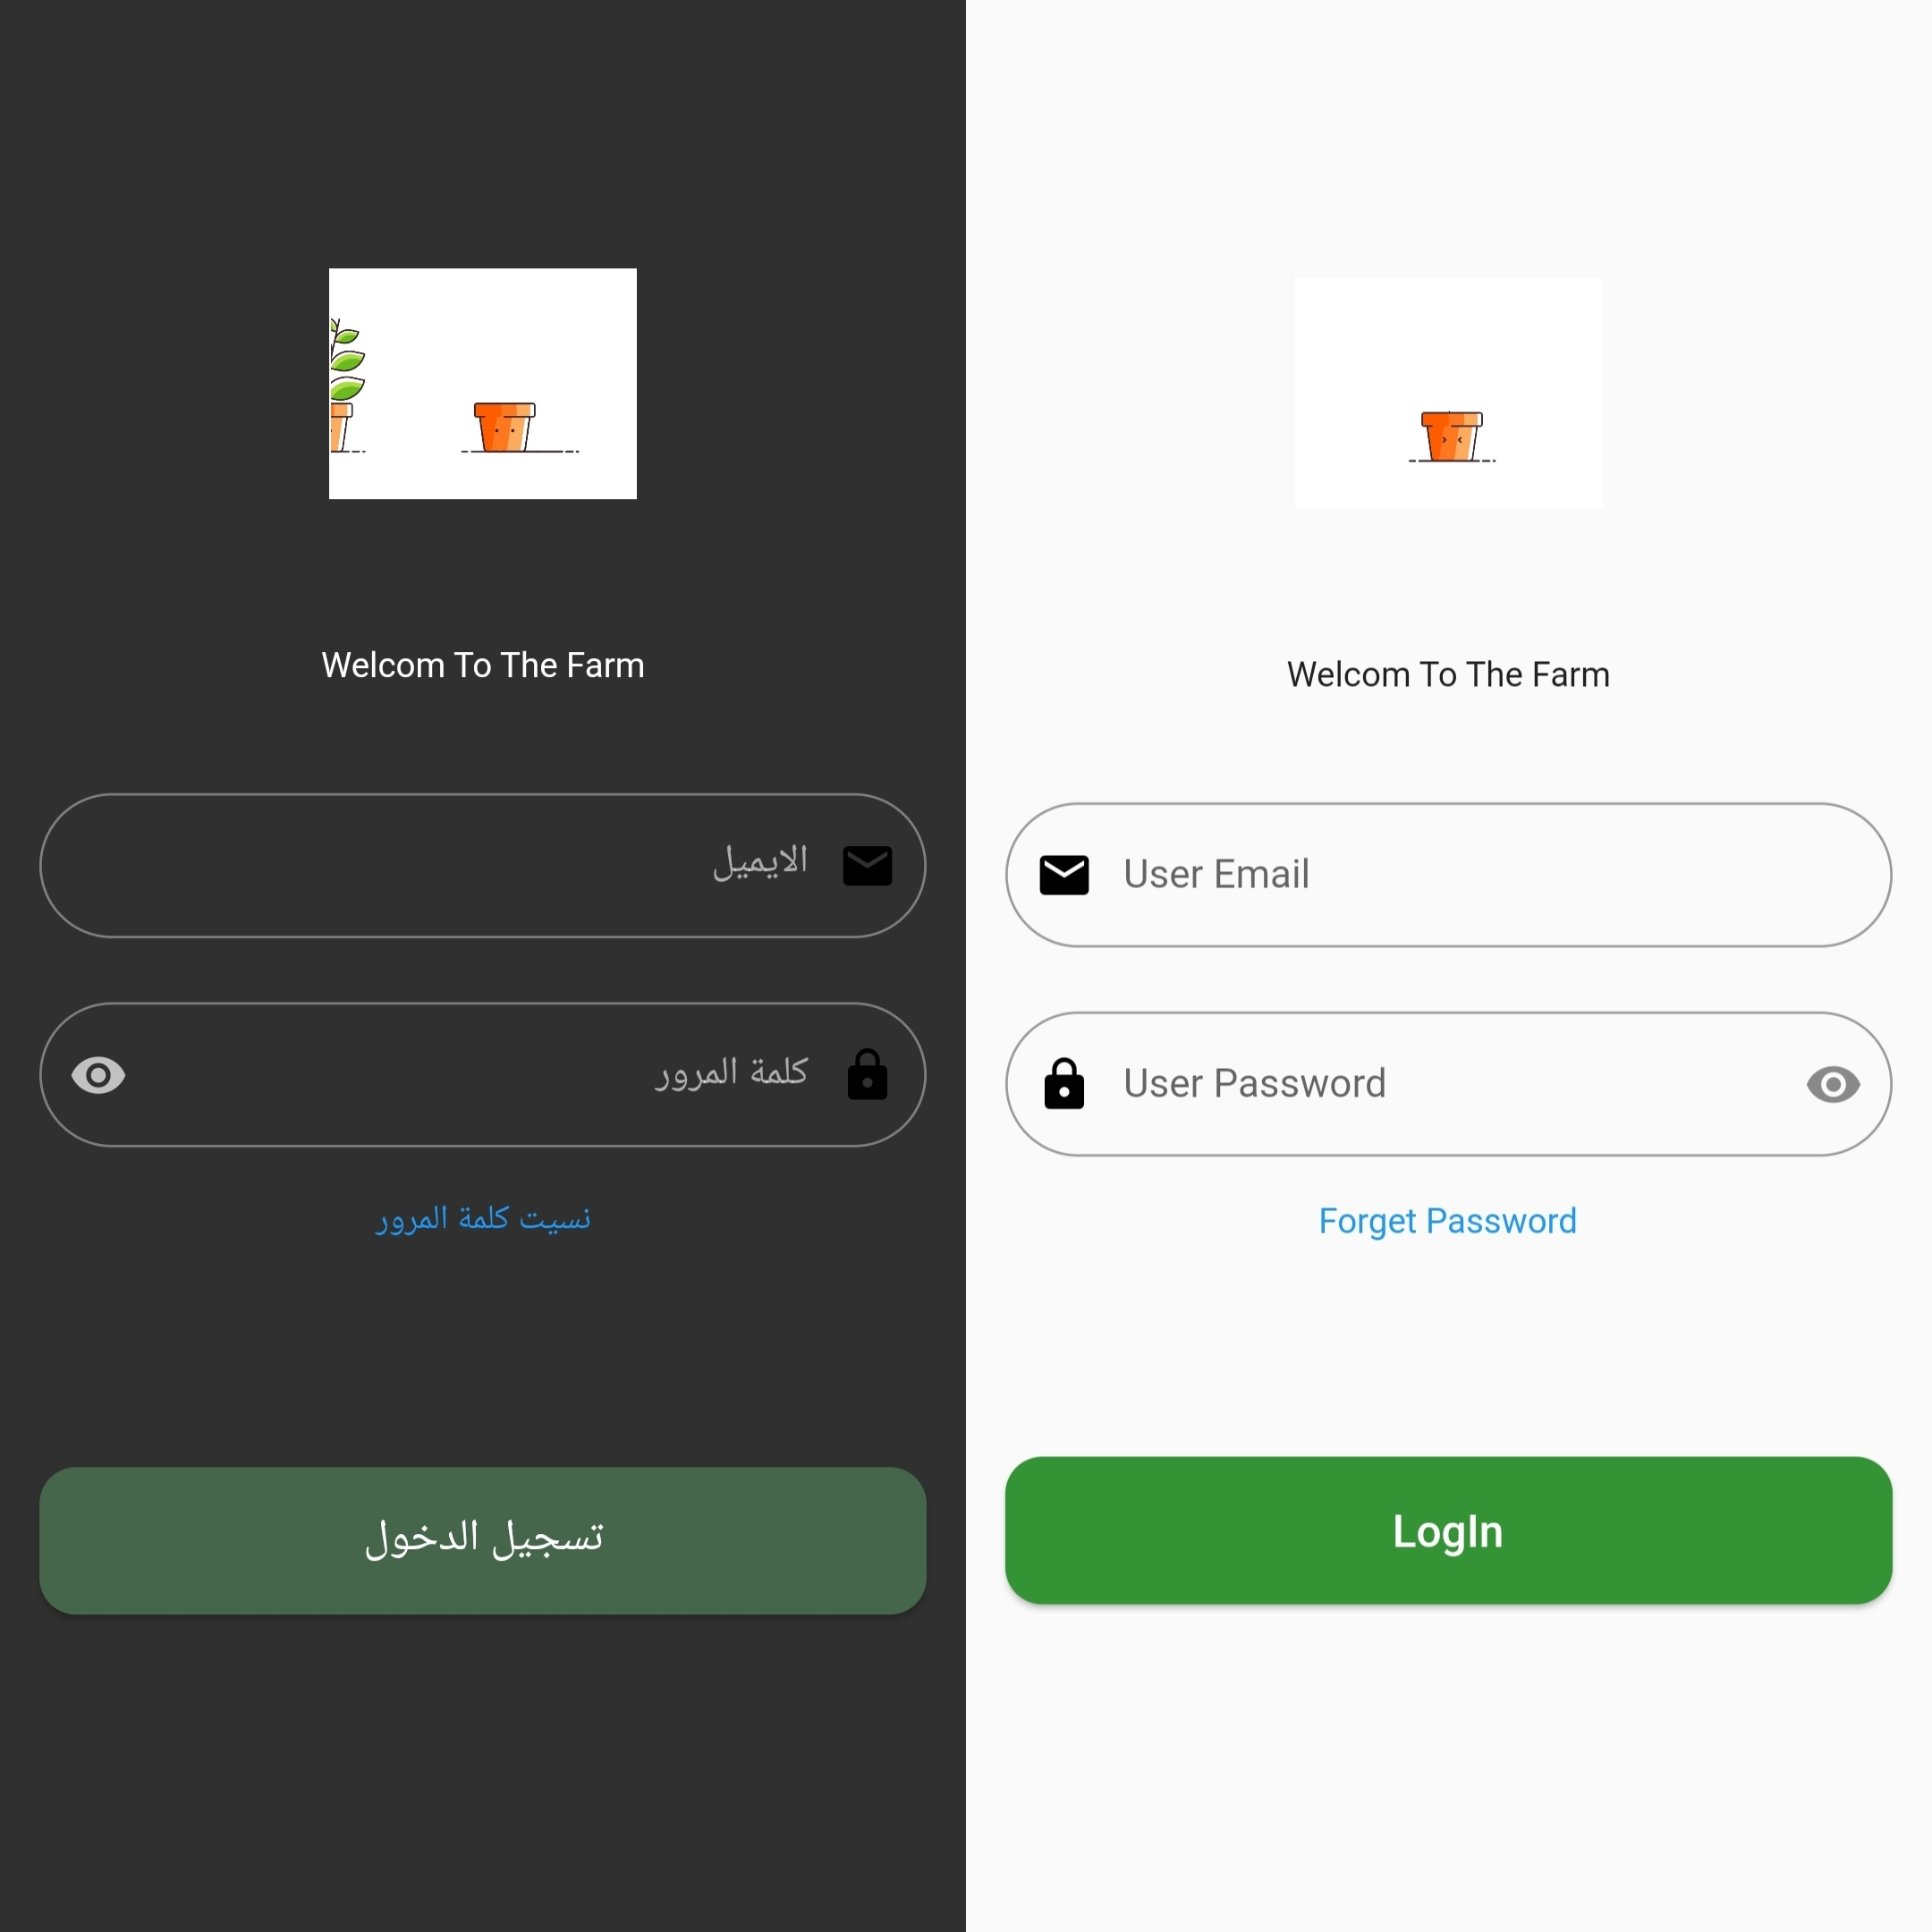
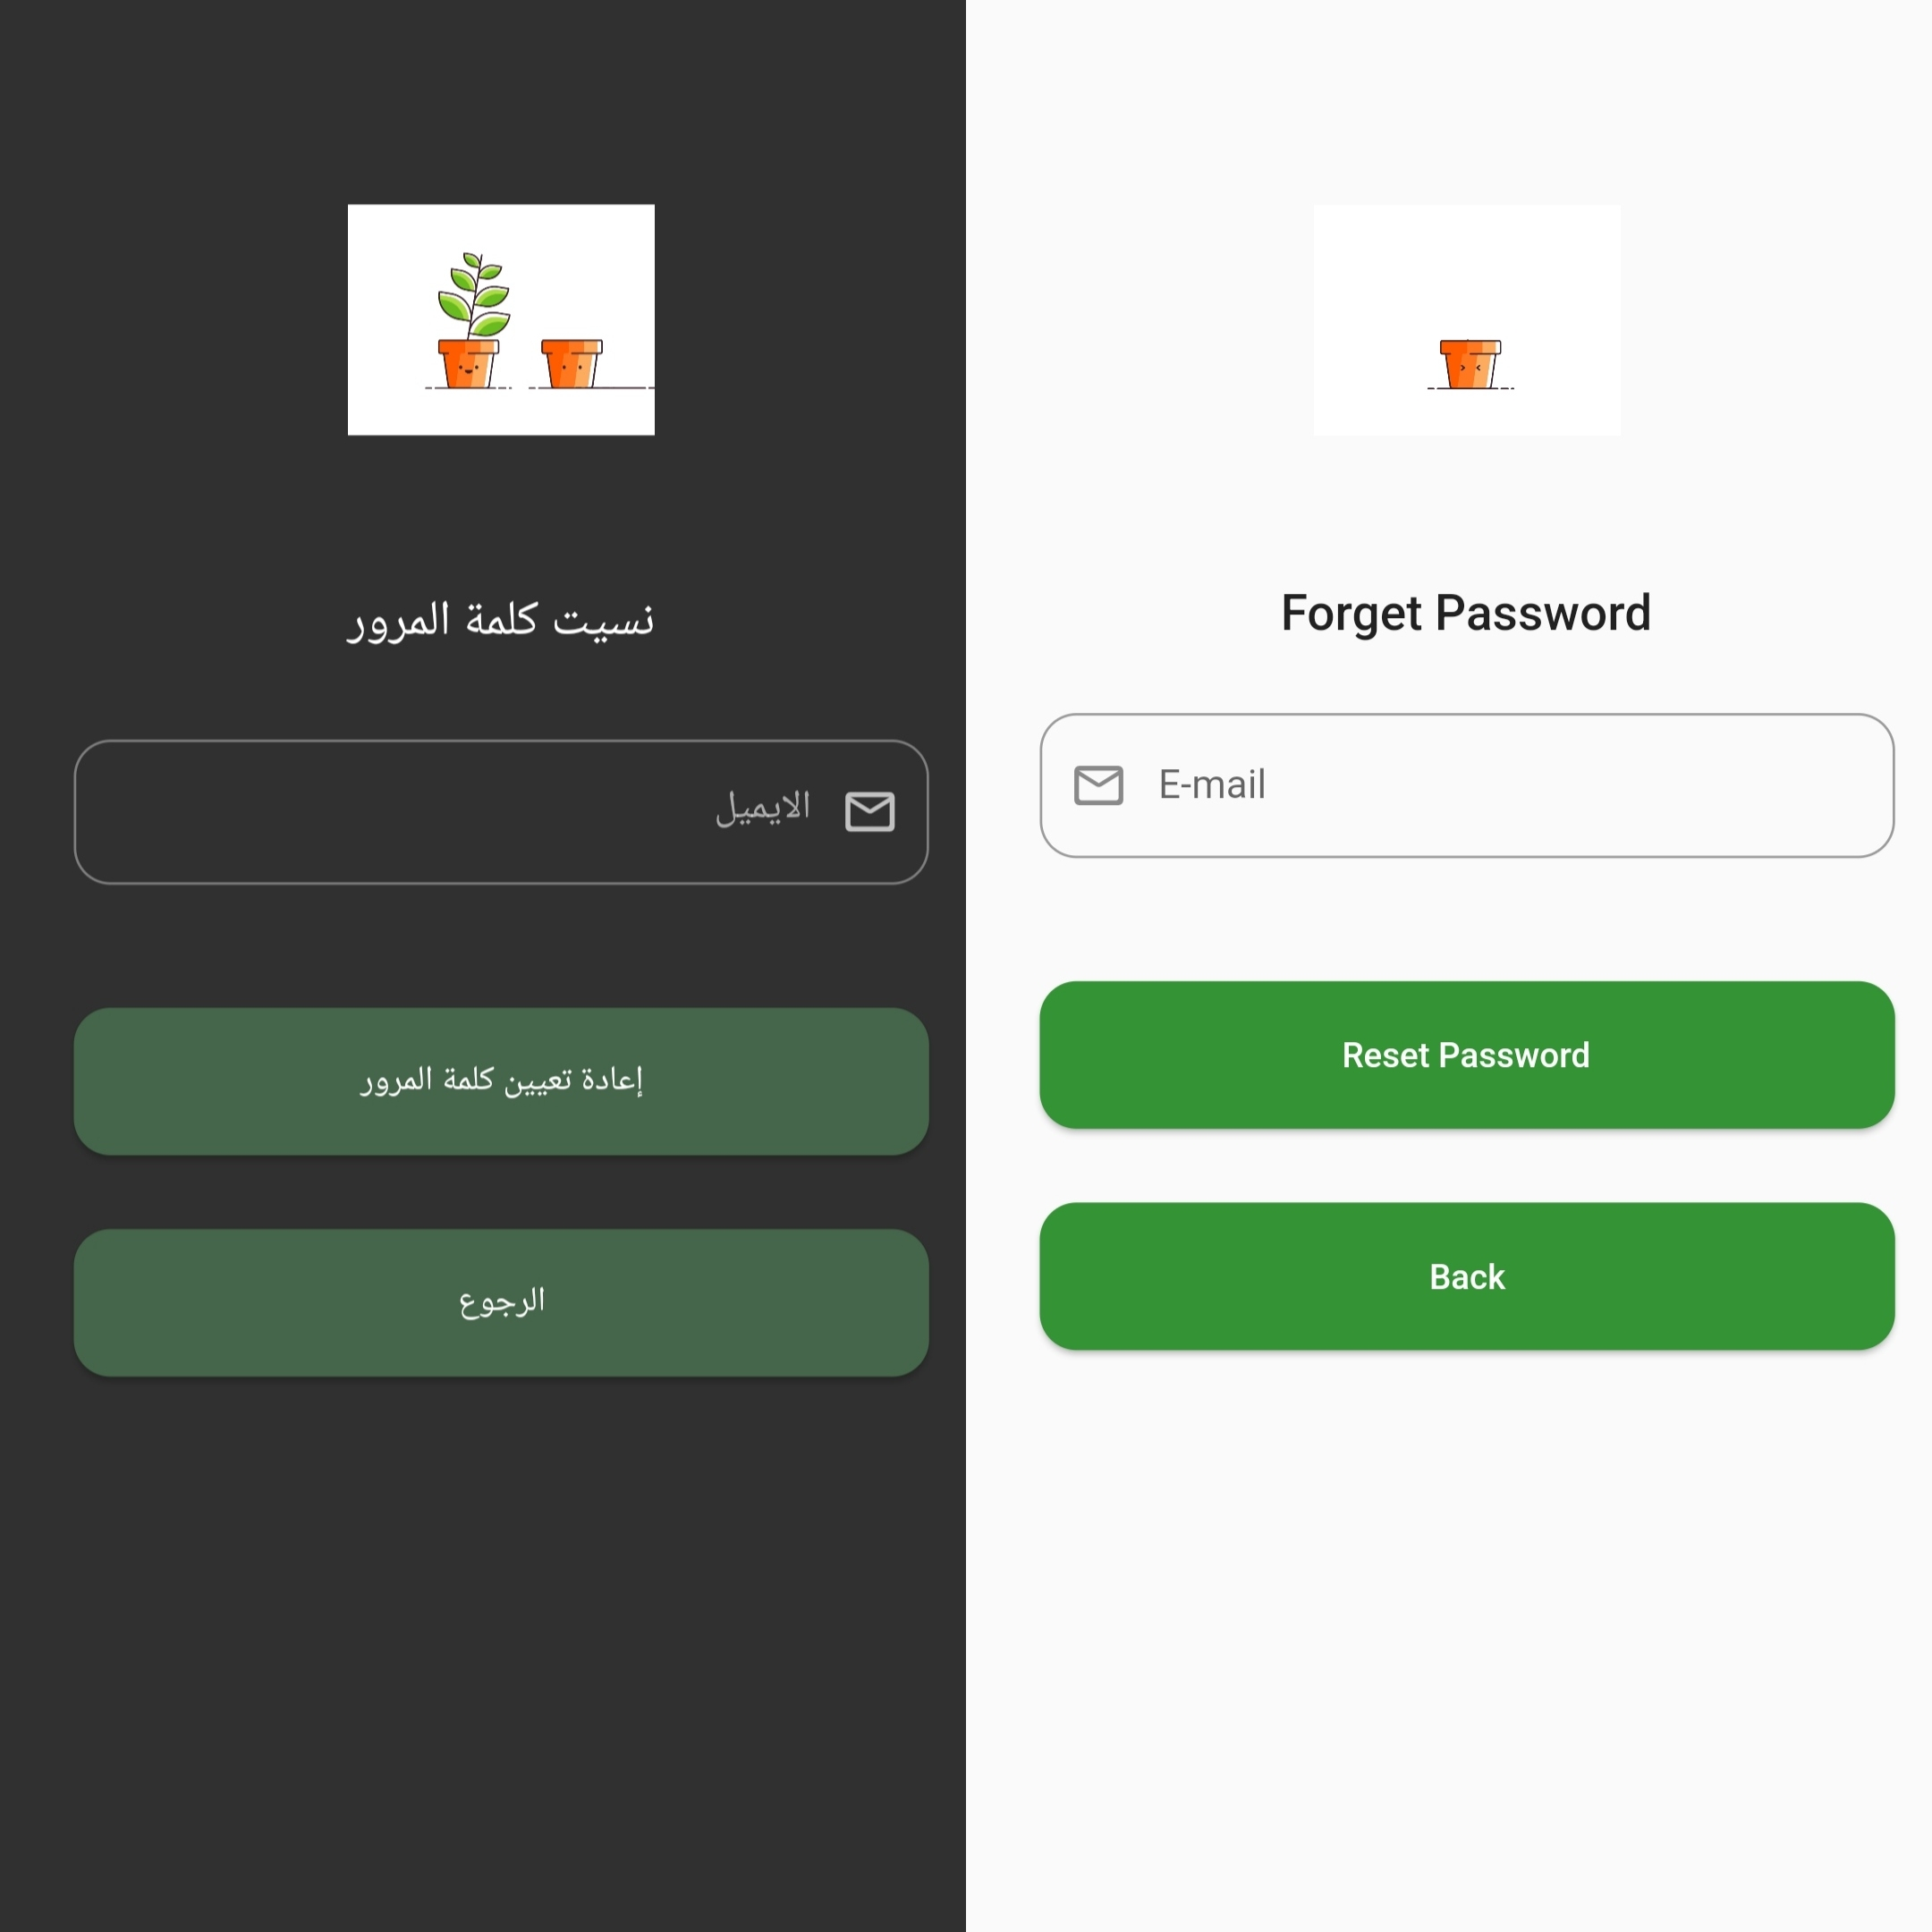
Flutter application login and forget the password page

Slide 19
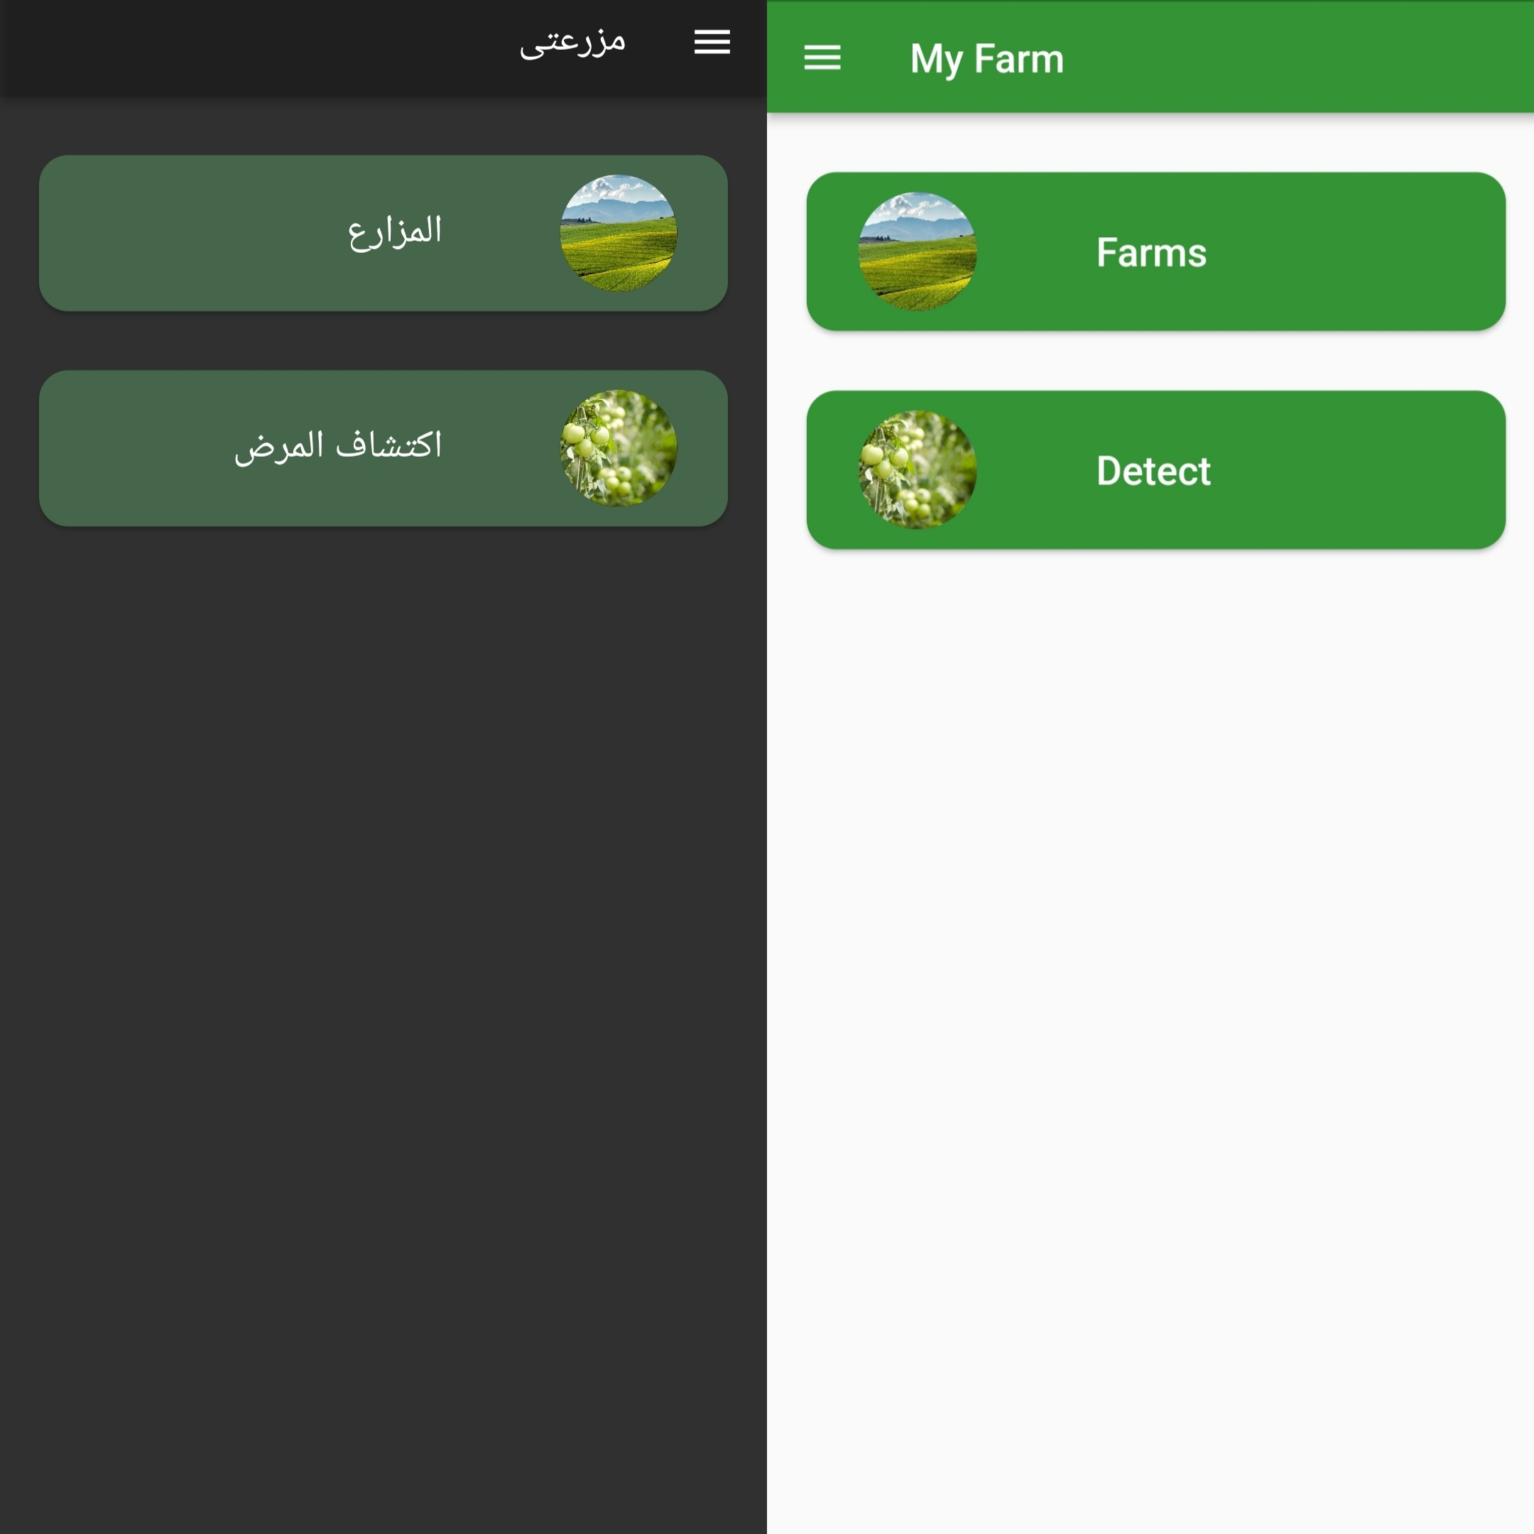
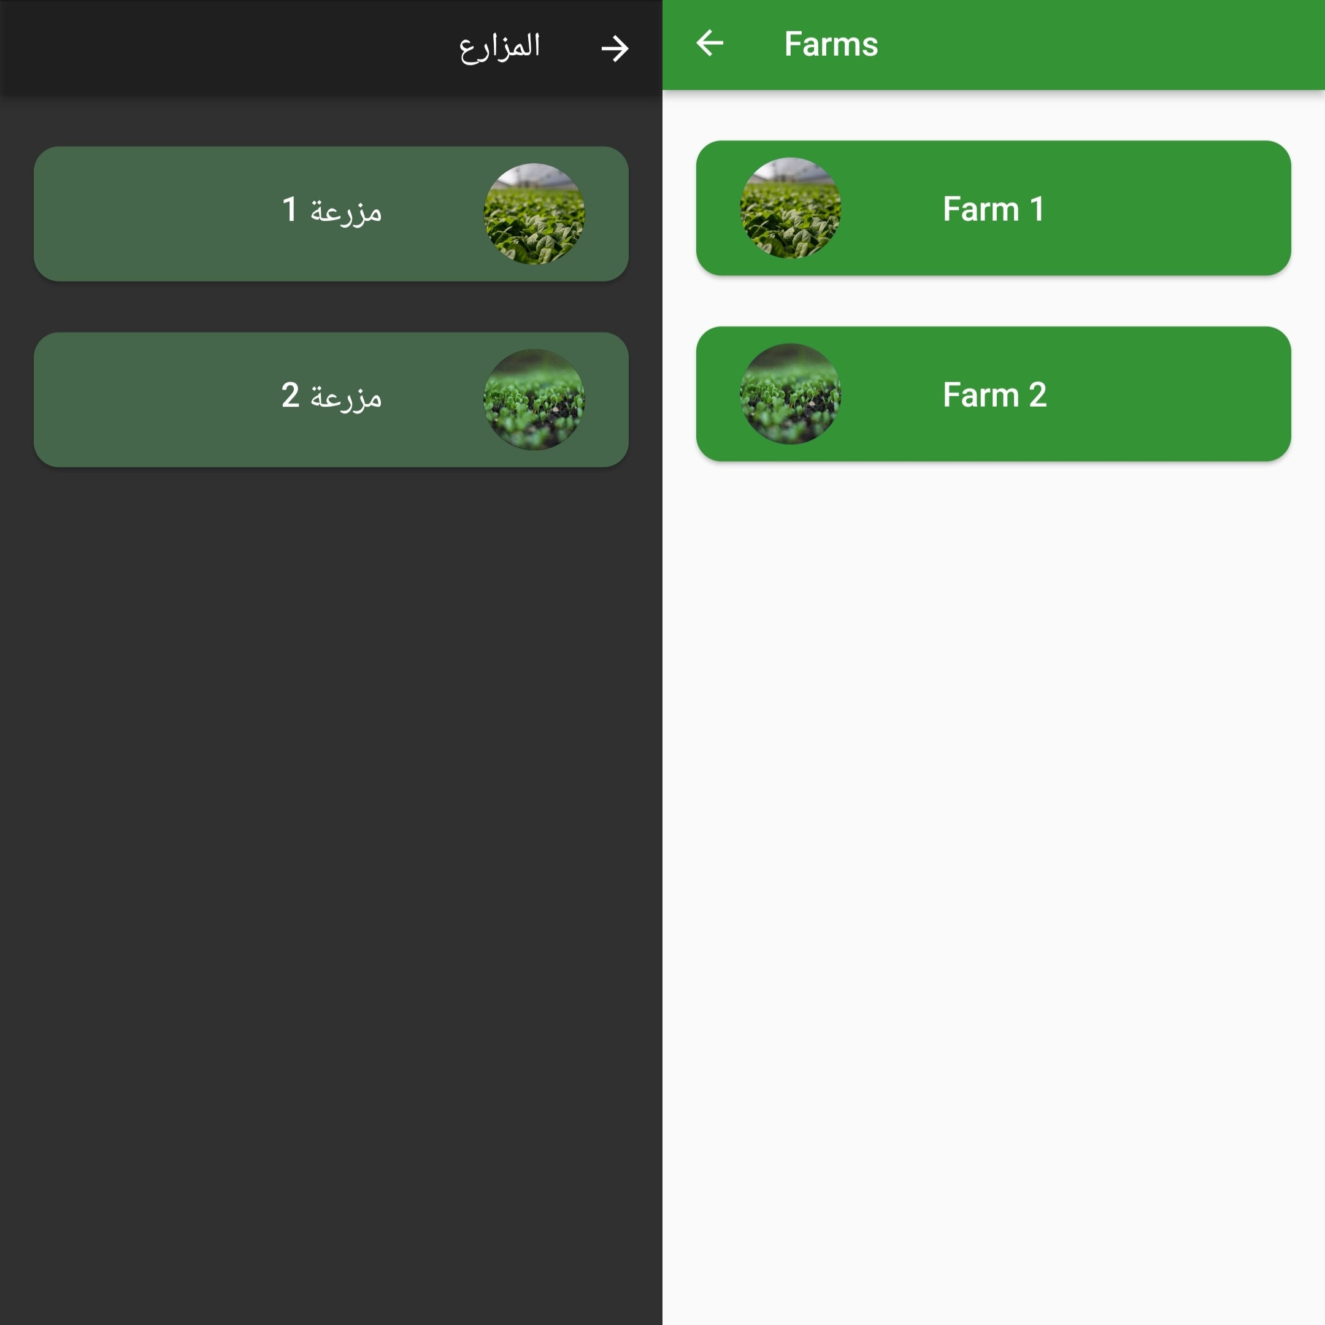
Flutter application Main page when logging in
The main page contains 2 buttons,
The first one gives the user access to their farms and information about the farm.
The second button leads to a page to either capture a picture or use an already existing one for detecting plant diseases

Slide 20
Flutter application farms feedback page
This page gives the user access to the farms they have logged into the system and pressing each button gives information about the farm.

Slide 21
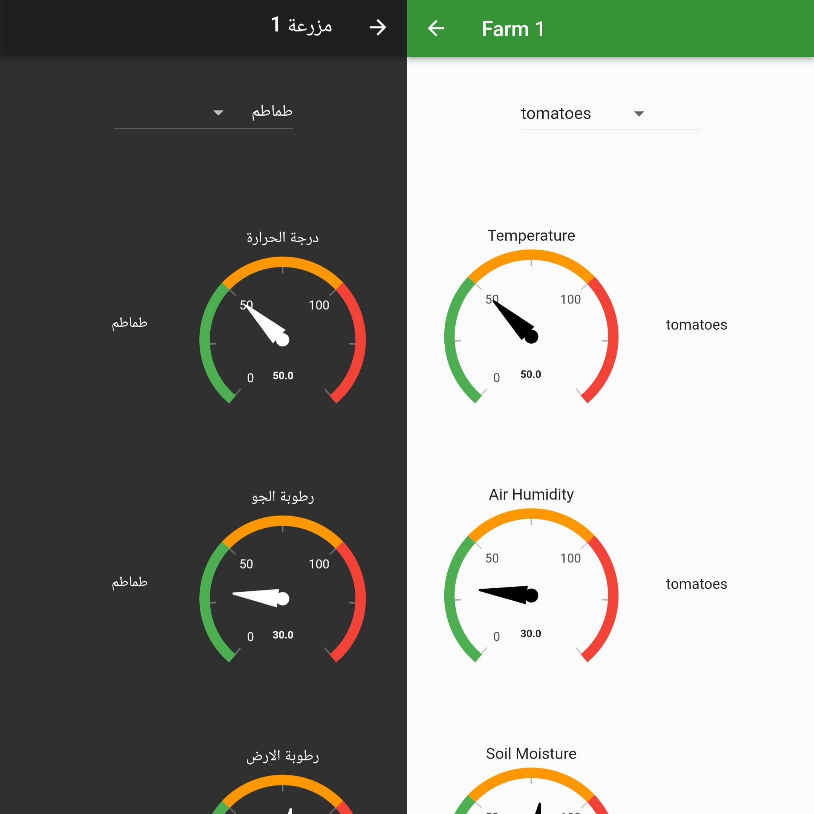
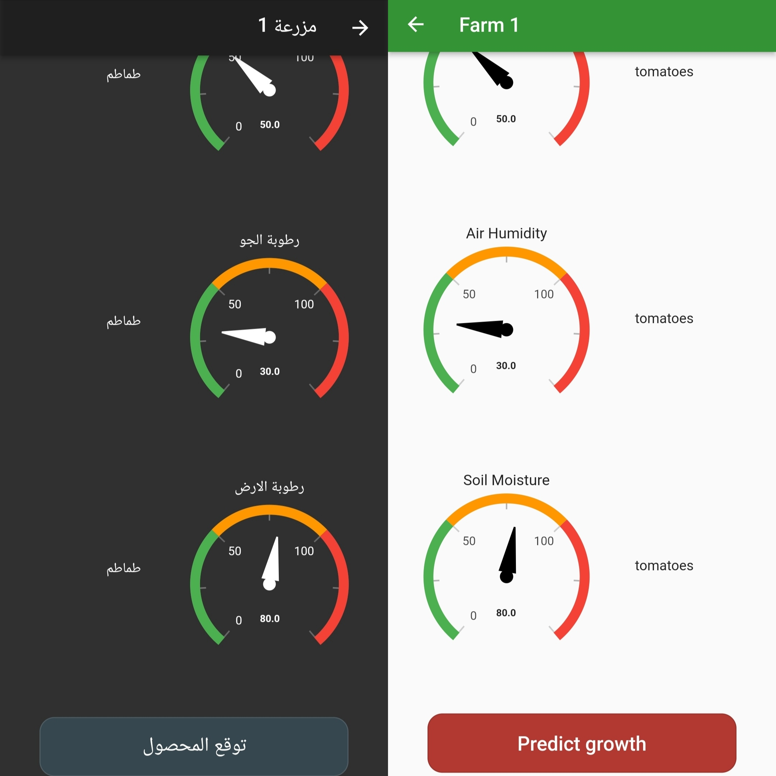
Flutter application farm feedback page

Slide 22
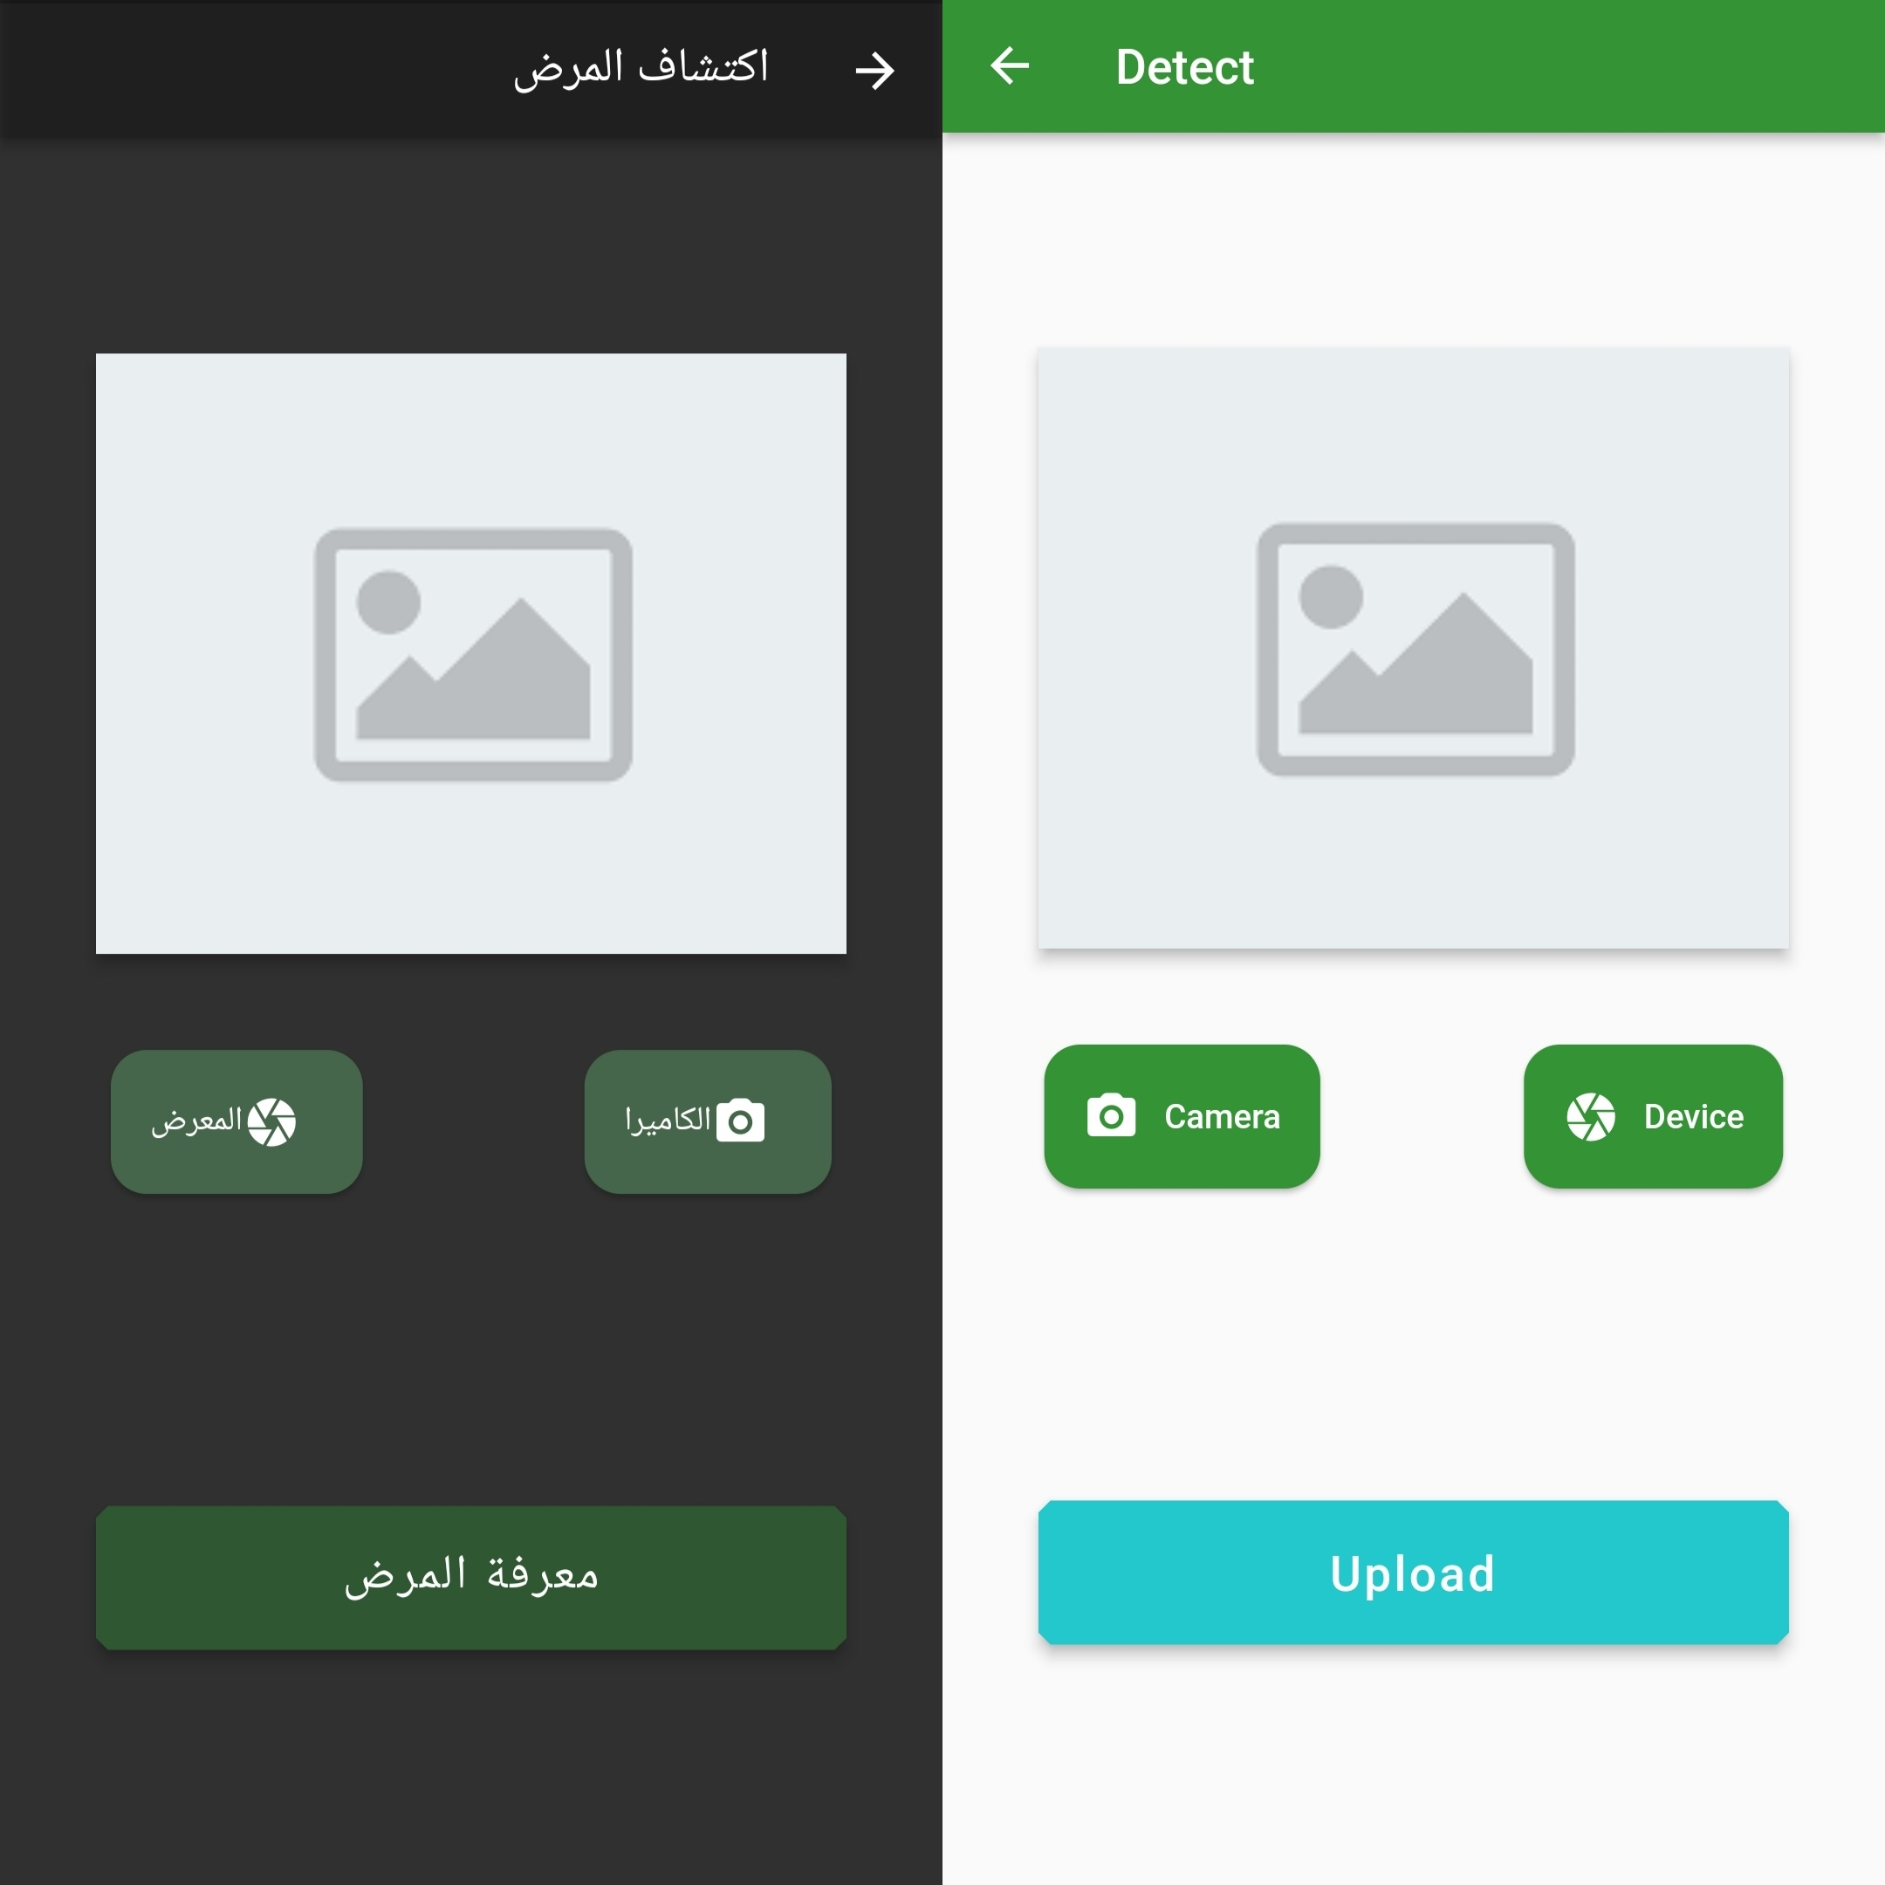
Flutter application Plant disease detection page
page to either capture a picture or use an already existing one for detecting plant diseases.

Slide 23
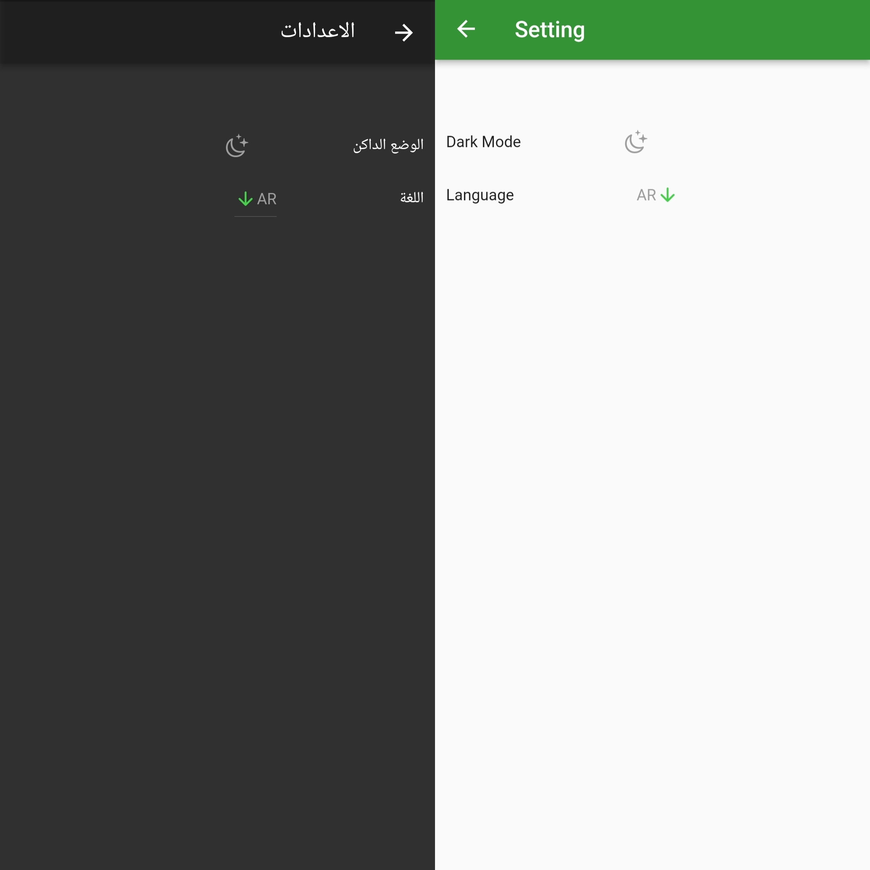
Flutter application dark mode and language option
For ease of use for the user we include 2 languages and both light and dark mode.

Slide 24
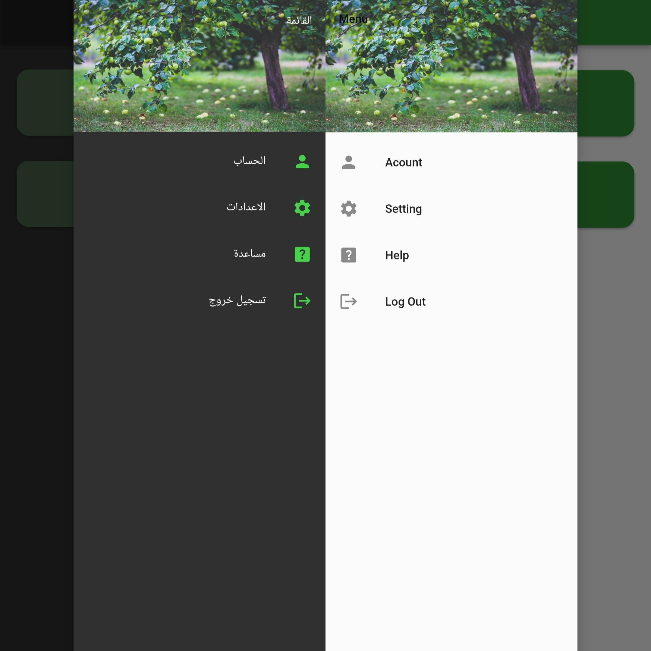
Flutter application profile page
Profile page where the users can access their accounts, have the setting for the application, get help, and log out.

Slide 25
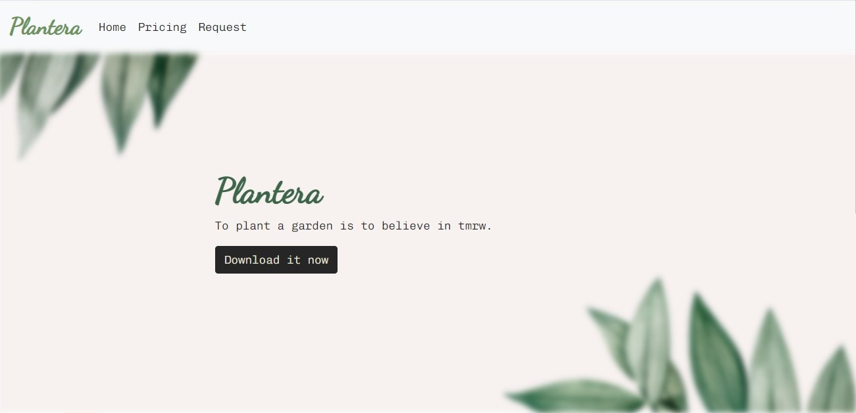
website
The home page, where the user can install the application on both the apple store and google play.

Slide 26
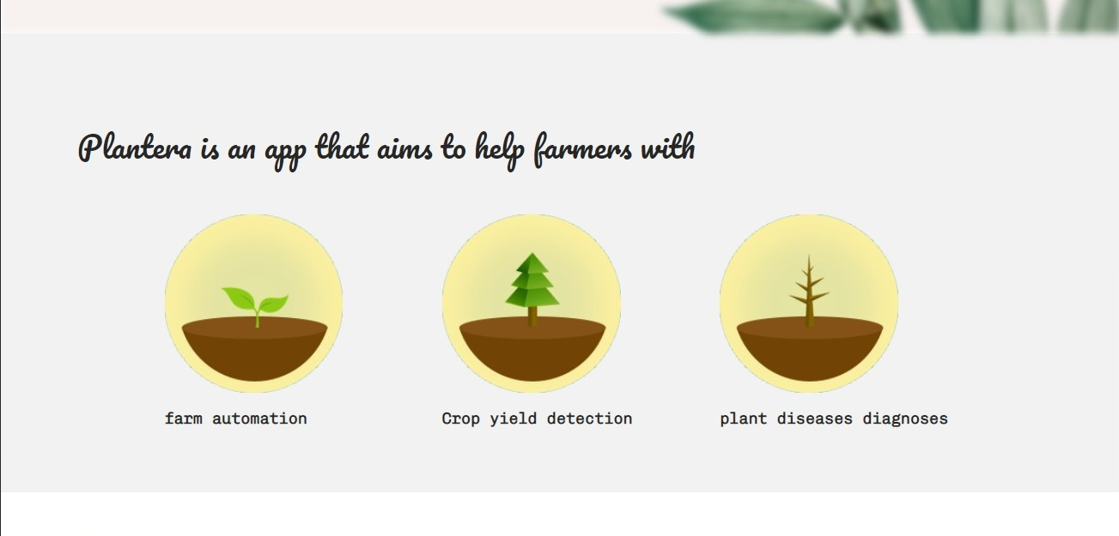
website
Page to view the services offered by Plantera.

Slide 27
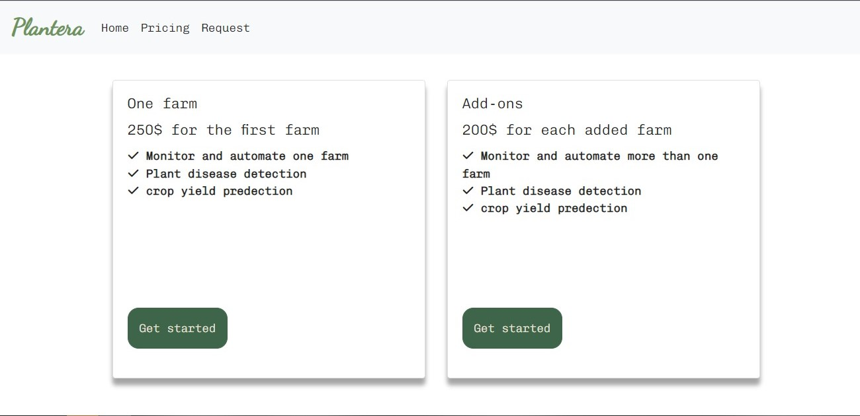
website
Pricing page, where all the plans are available is giving to the user.

Slide 28
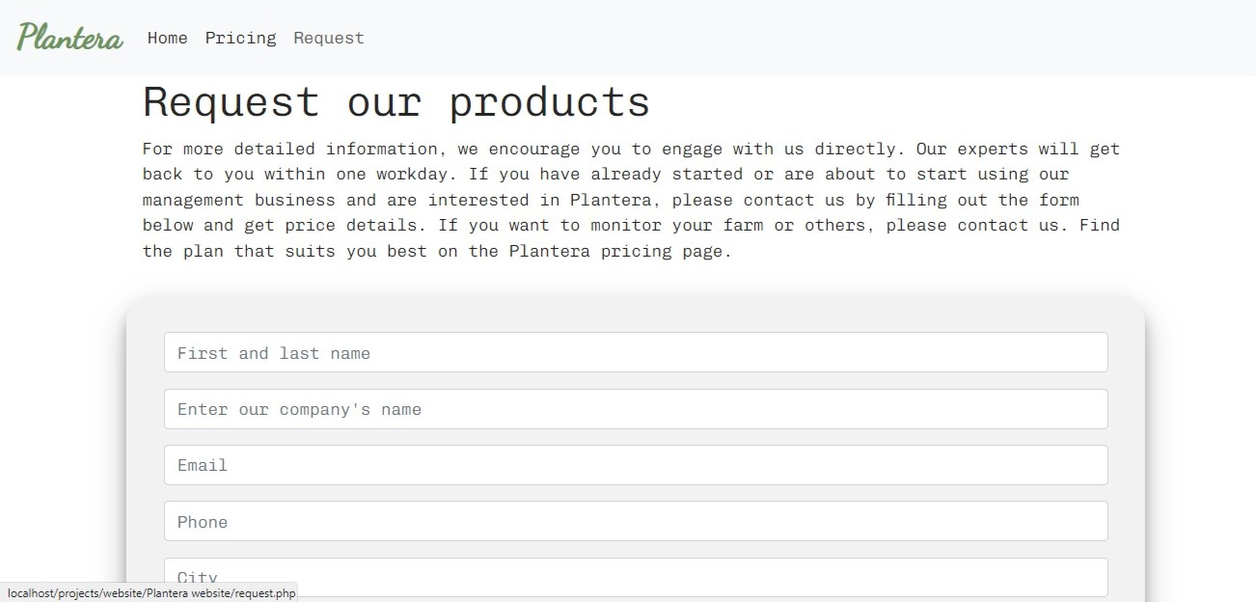
website
Request page where the user can request to have the system installed.

Slide 29
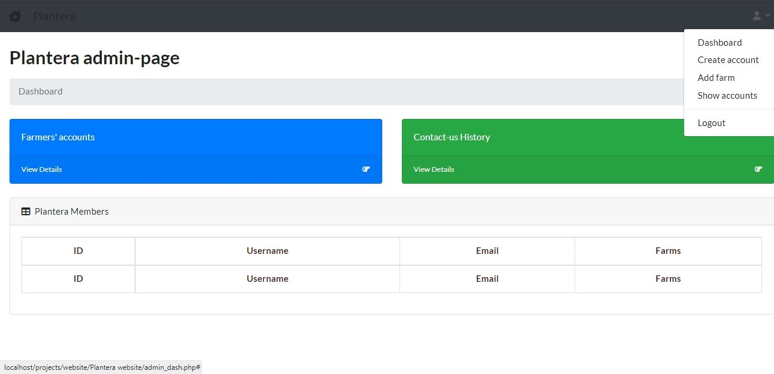
website
Admin page to display information about requests from new users and information about existing users(Dashboard).

Slide 30
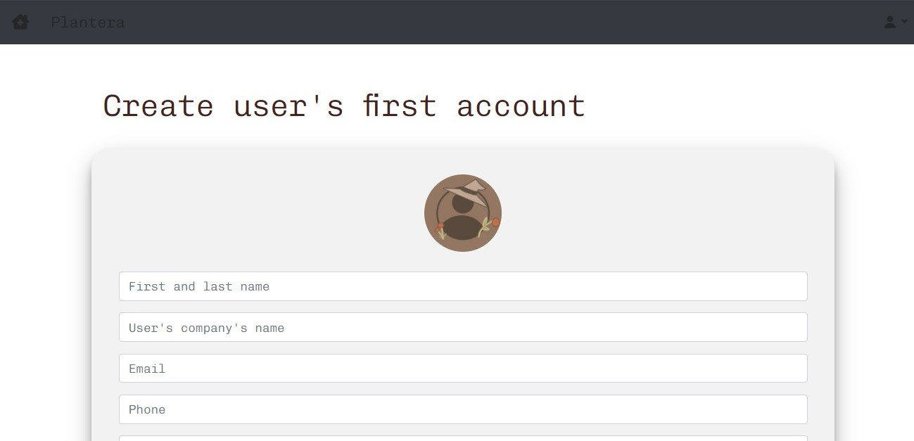
website
Page to add new users (farmers).

Slide 31
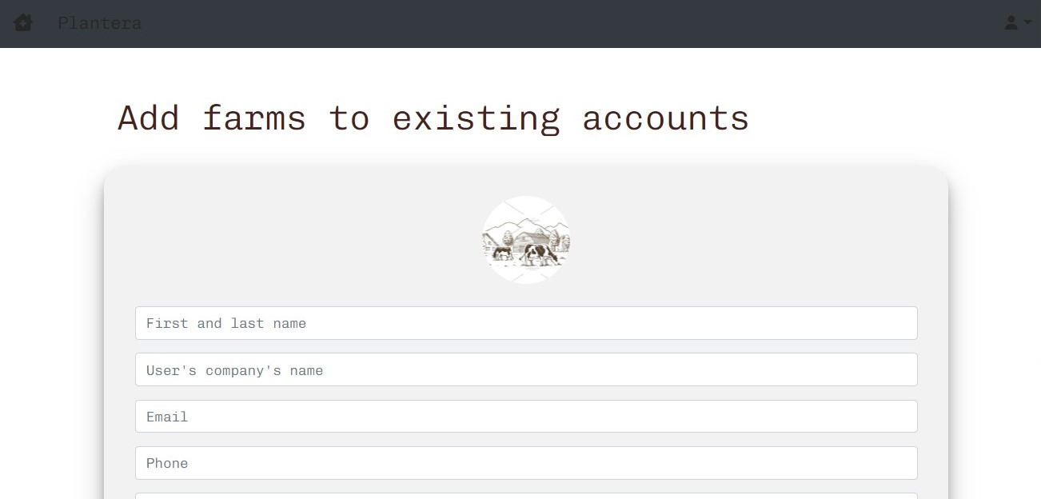
website
Page to add a new farm.

Slide 32
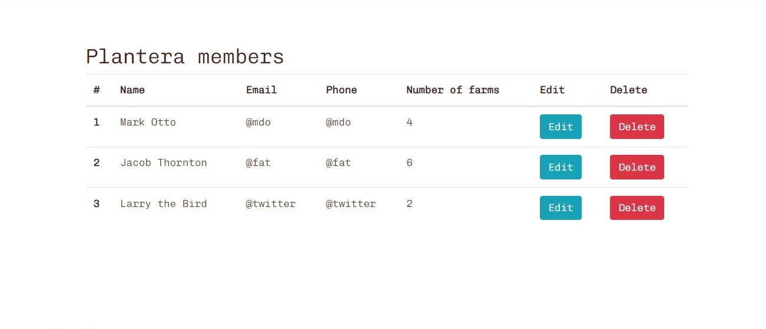
website
A page to display the subscribed members.

Slide 33
06
Future Plans
What is done and the plan for the future

Slide 34
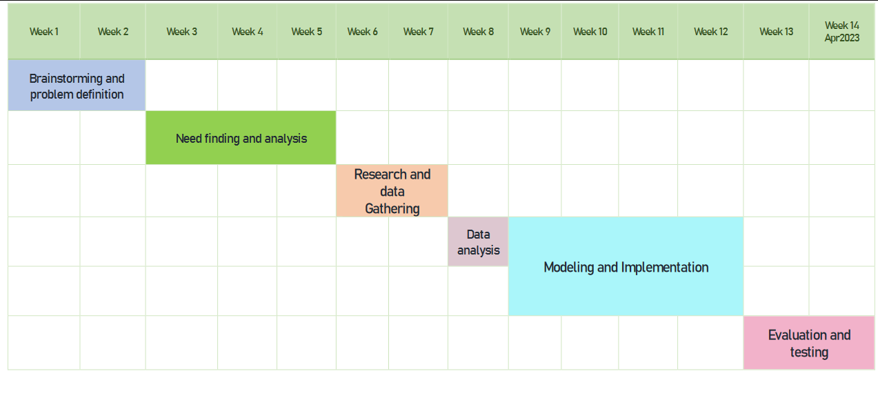
Model Grant chart

Slide 35
What is done so far
Flutter mobile application interface.
Website frontend for users’ page and admin page.
Plant disease detection.

Slide 36
What is needed to be done
Website backend.
Mobile application backend.
Firebase.
API to host the model.
Hardware.

Slide 37
Plan to finish the project
Week 1 | Week 2 | Week 3 | Week 4 | Week 5 | Week 6 | Week 7 | Week 8 | Week 9
Work on hardware |  | Connect application with hardware |  |  | Connect application with web
Work on the website’s backend and Firebase
 |  |  |  |  |  |  |  | API
10th and 11th weeks to test

Slide 38

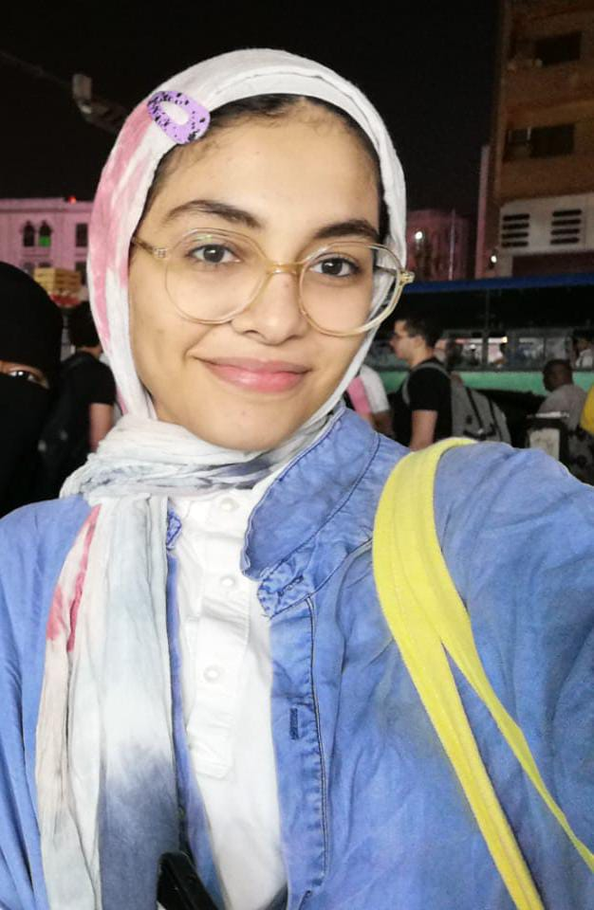
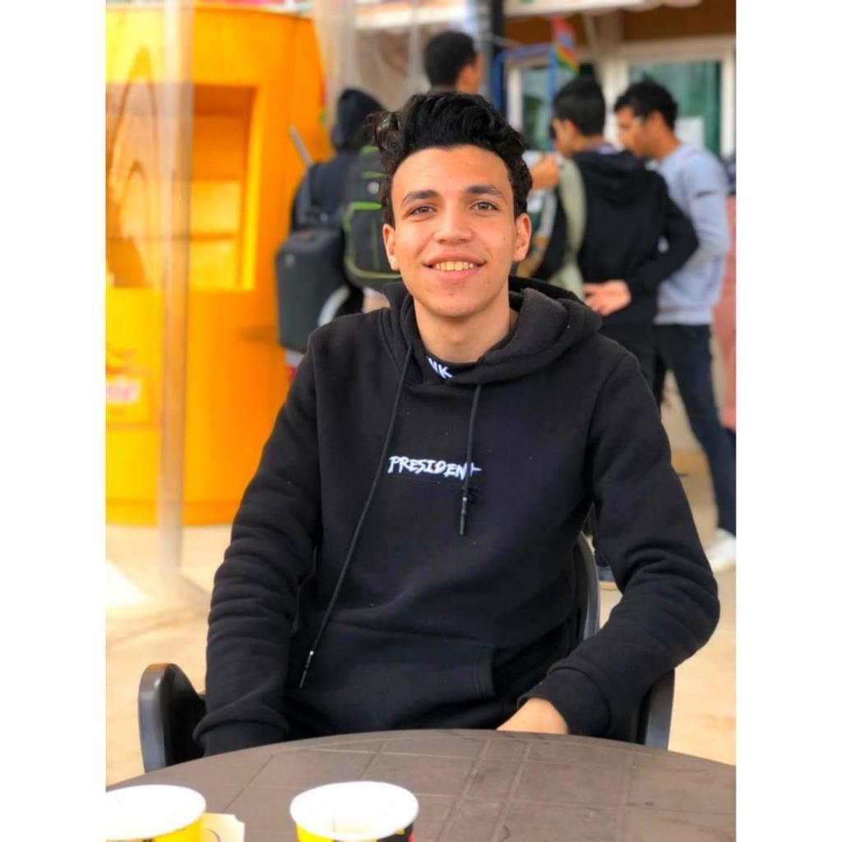
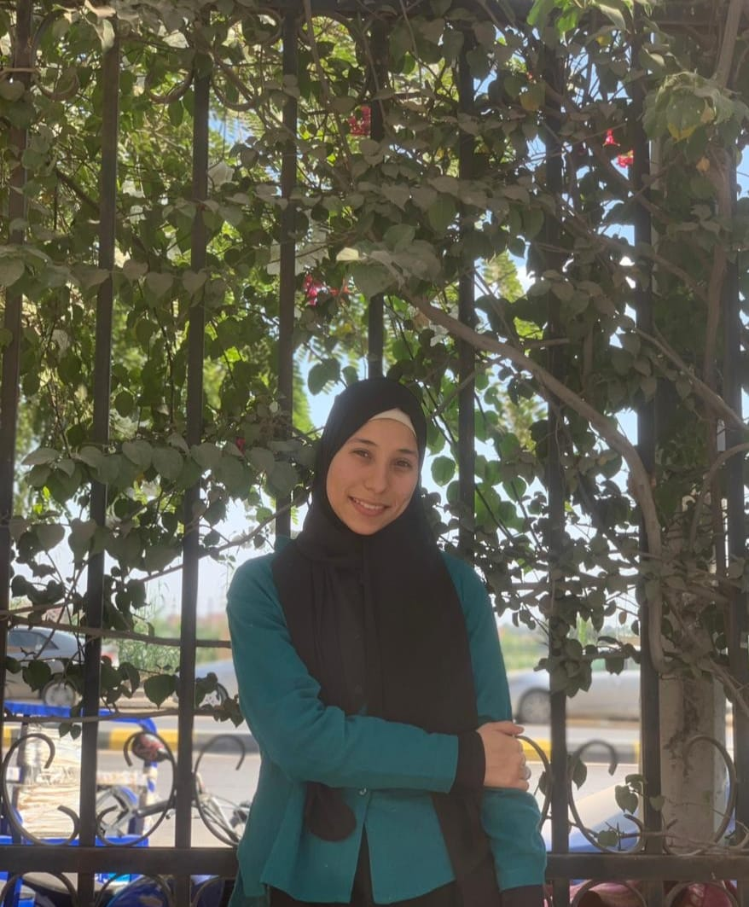
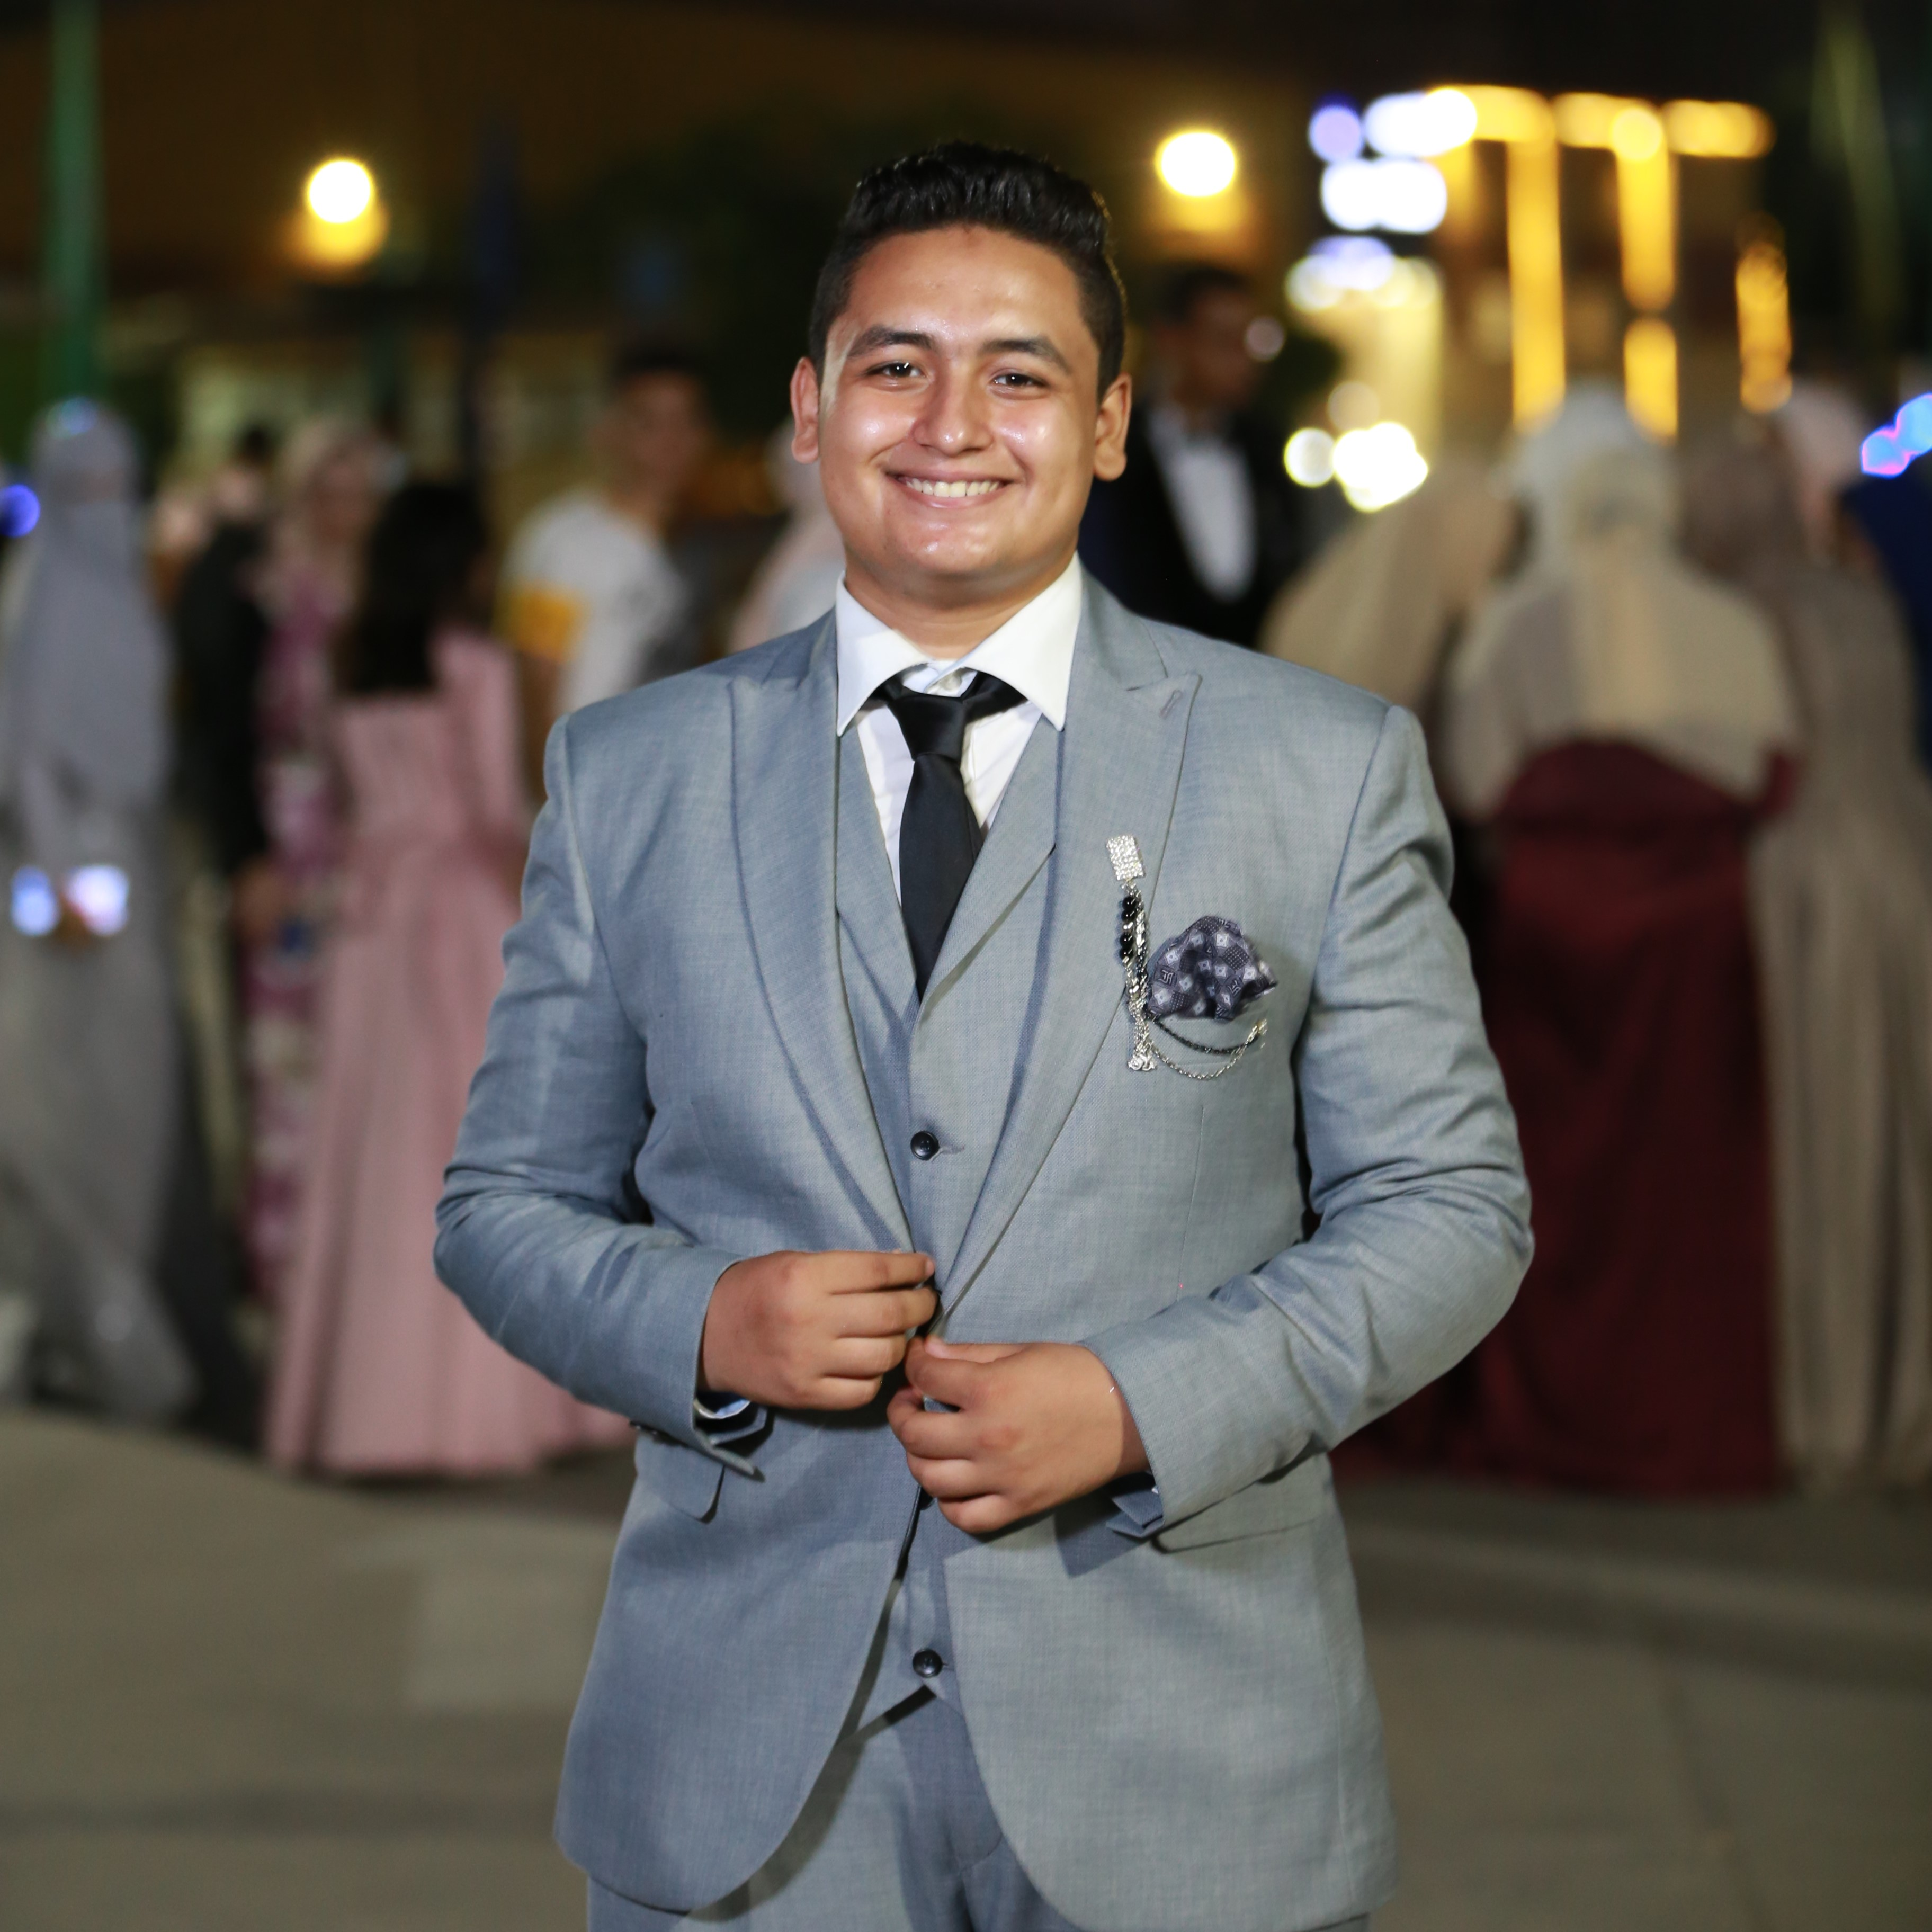
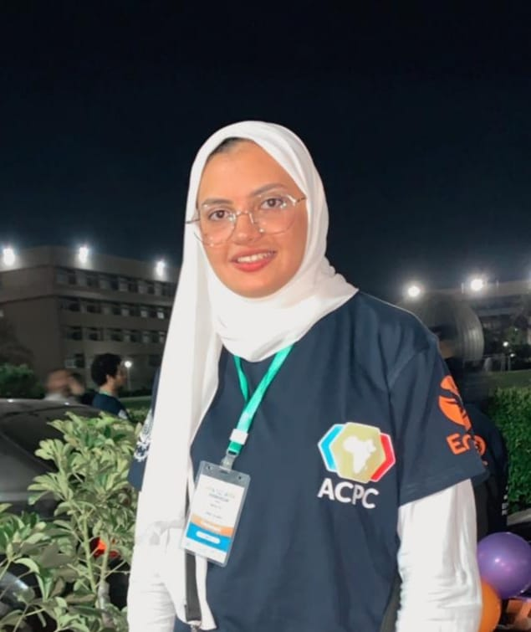
Team
Amira Ahmed Khater
Ahmed Muhammad Morsi
Dina Abdallah Muhamad
Osama Sayed Ahmed
Responsible for hardware and IOT
Responsible for website and firebase, API
Responsible for ml and learning model
Responsible for ml and learning model
Osama Mohamed Hussain
Mariam Hossam Goda
Responsible for flutter application and firebase
Responsible for flutter application and firebase

Slide 39
Thank you

